Slide 1

Big-O notation. Algorithm complexity
Notes:
Just into on why we’re here today and what’s the point of having this presentation. Brifely touch the topic of presenters: SZ, OZ, IL, and KK.
In the end: passing the floot to Sviatlana.

Slide 2
Basic problems with complexity
Why should we care about it?
Efficient algorithms execute MUCH faster:
Quick sort of array with billion elements will take 5 minutes, bubble sort – 400 years
Search in SQL DB with a billion elements by id takes few milliseconds when you have a correctly created index, and 10 seconds when not
Depending on the workload, ArrayList can be 1000 times faster than LinkedList, or vise versa
Why can’t we exactly calculate how much time the algorithm will take to execute?
Different computers have different processors, memory, etc.
Different programs run on background; you don’t know how much CPU time your program will receive
Different air temperature, humidity, etc. do affect processor speed
How do we estimate the algorithm complexity and execution time?
Simply count the CPU instructions based on the input size

Slide 3
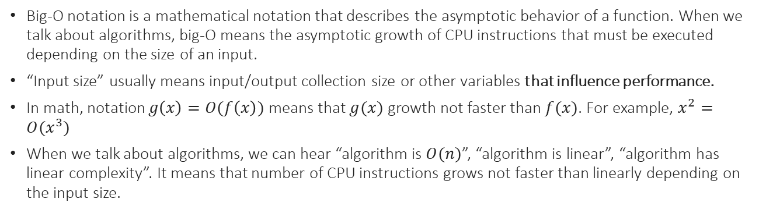
What is big-O notation
Big-O notation is a mathematical notation that describes the asymptotic behavior of a function. When we talk about algorithms, big-O means the asymptotic growth of CPU instructions that must be executed depending on the size of an input.
“Input size” usually means input/output collection size or other variables that influence performance.
In math, notation $g\left(x\right)=O(f\left(x\right))$ means that $g(x)$ growth not faster than $f(x)$. For example, $x^{2}=O(x^{3})$
When we talk about algorithms, we can hear “algorithm is $O(n)$”, “algorithm is linear”, “algorithm has linear complexity”. It means that number of CPU instructions grows not faster than linearly depending on the input size.

Slide 4
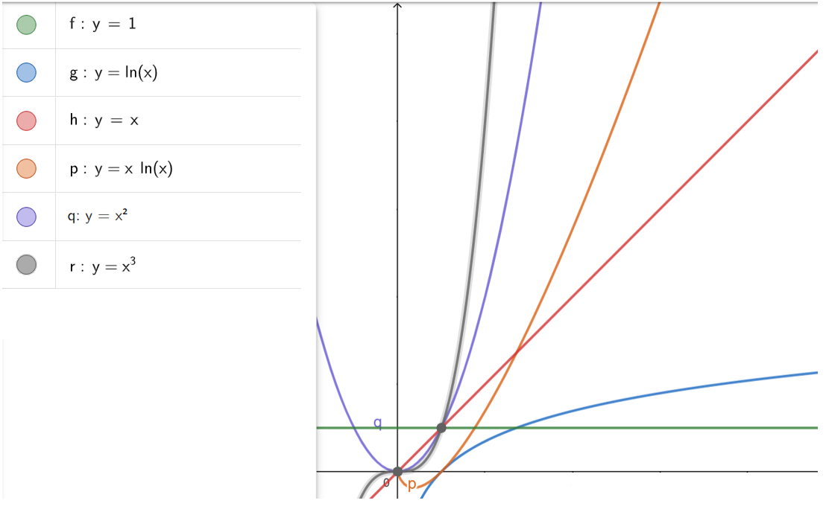
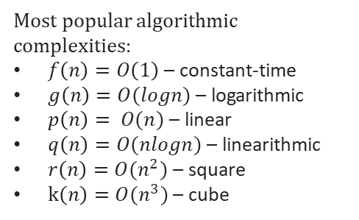
Most common functions
Most popular algorithmic complexities:
$f\left(n\right)=O\left(1\right)$ – constant-time
$g\left(n\right)=O(logn)$ – logarithmic
$p\left(n\right)= O(n)$ – linear
$q\left(n\right)=O(nlogn)$ – linearithmic
$r\left(n\right)=O(n^{2})$ – square
$k\left(n\right)=O(n^{3})$ – cube

Slide 5
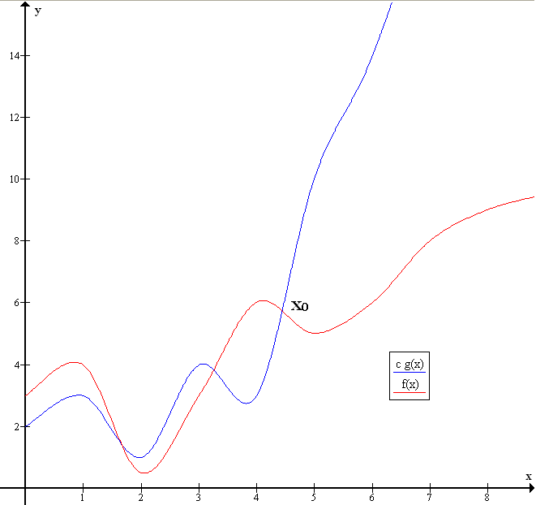
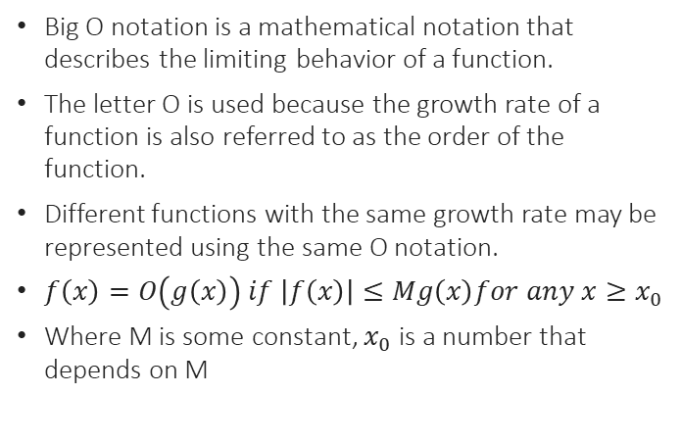

Big-O in Math
Big O notation is a mathematical notation that describes the limiting behavior of a function.
The letter O is used because the growth rate of a function is also referred to as the order of the function.
Different functions with the same growth rate may be represented using the same O notation.
$f\left(x\right)=O\left(g\left(x\right)\right) if \left|f\left(x\right)\right|≤Mg\left(x\right)for any x≥x_{0}$
Where M is some constant, $x_{0}$ is a number that depends on M
$$f\left(x\right)=O\left(g\left(x\right)\right), M=1, x_{0}≈4.5$$

Slide 6
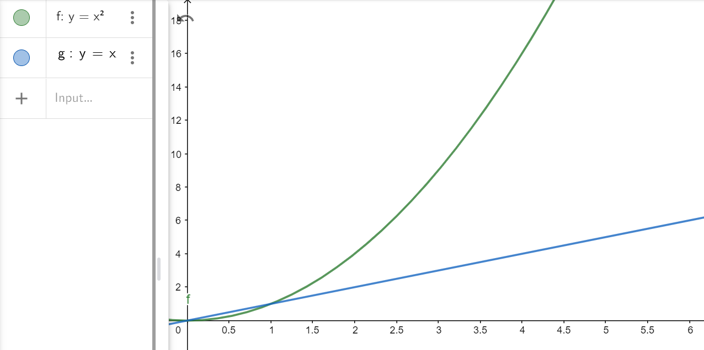
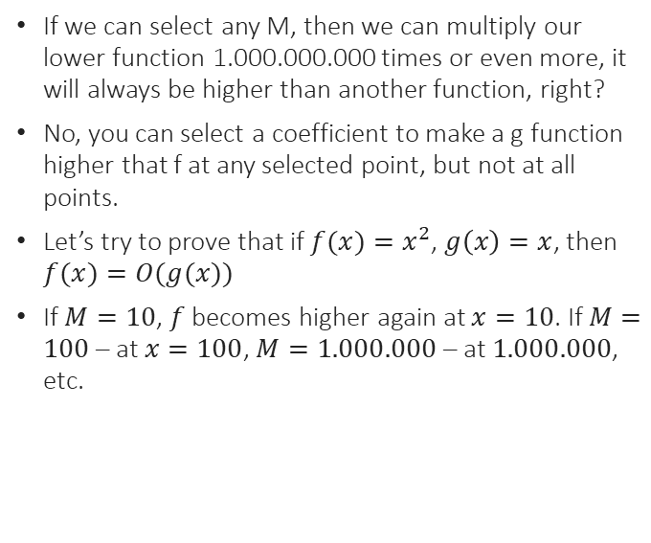
Big-O in Math
If we can select any M, then we can multiply our lower function 1.000.000.000 times or even more, it will always be higher than another function, right?
No, you can select a coefficient to make a g function higher that f at any selected point, but not at all points.
Let’s try to prove that if $f(x)=x^{2}$, $g\left(x\right)=x$, then $f(x)=O(g(x))$
If $M=10$, $f$ becomes higher again at $x=10$. If $M=100$– at $x=100$, $M=1.000.000$ – at $1.000.000$, etc.

Slide 7

Big-O in Math
Selected properties of O:
Factor can be dropped: $y=3x=O\left(x\right), y=\frac{x^{2}}{10}=O(x^{2})$
If the function f can be written as a finite sum of other functions, then the fastest growing one determines the order of function: $y=2x^{2}+5x∗\log\left(x\right)+10x+2=O\left(2x^{2}\right)=O(x^{2})$
Let’s see some examples:
$y=x+5=$
$O(x)$
$y=5x+x^{3}=$
$O(x^{3})$
$y=x∗log(x)+\frac{x^{2}}{1000}=$
$O(x^{2})$
$y=x!=$ $O(x^{x})$ – Stirling approximation

Slide 8
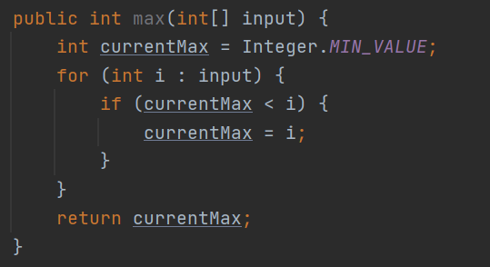
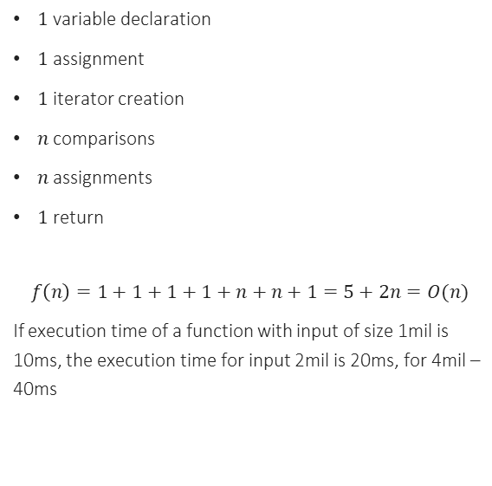
Big-O example
$1$ variable declaration
$1$ assignment
$1$ iterator creation
$n$ comparisons
$n$ assignments
$1$ return
$$f\left(n\right)=1+1+1+1+n+n+1=5+2n=O(n)$$
If execution time of a function with input of size 1mil is 10ms, the execution time for input 2mil is 20ms, for 4mil – 40ms

Slide 9
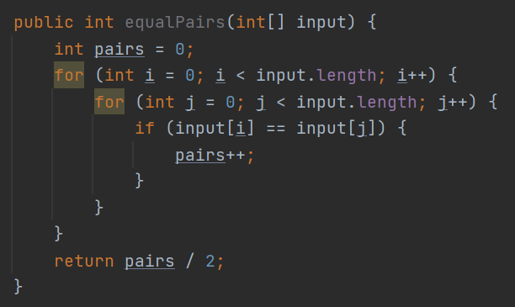
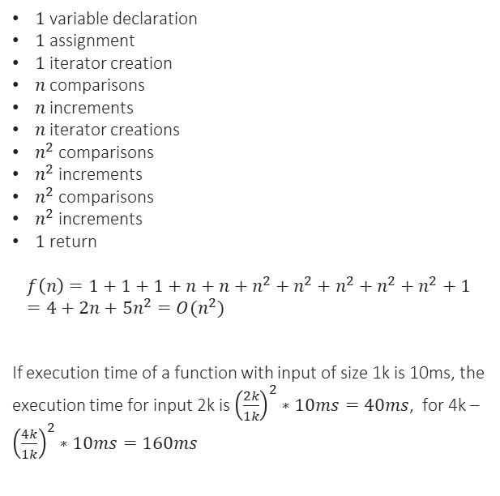
Big-O example
$1$ variable declaration
$1$ assignment
$1$ iterator creation
$n$ comparisons
$n$ increments
$n$iterator creations
$n^{2}$comparisons
$n^{2}$ increments
$n^{2}$ comparisons
$n^{2}$ increments
$1$ return
$$f\left(n\right)=1+1+1+n+n+n^{2}+n^{2}+n^{2}+n^{2}+n^{2}+1=4+2n+5n^{2}=O(n^{2})$$
If execution time of a function with input of size 1k is 10ms, the execution time for input 2k is ${\left(\frac{2k}{1k}\right)}^{2}∗10ms=40ms$, for 4k – ${\left(\frac{4k}{1k}\right)}^{2}∗10ms=160ms$

Slide 10
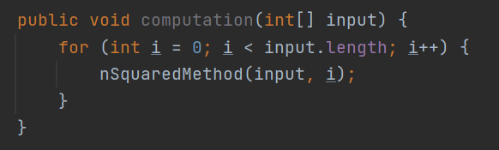
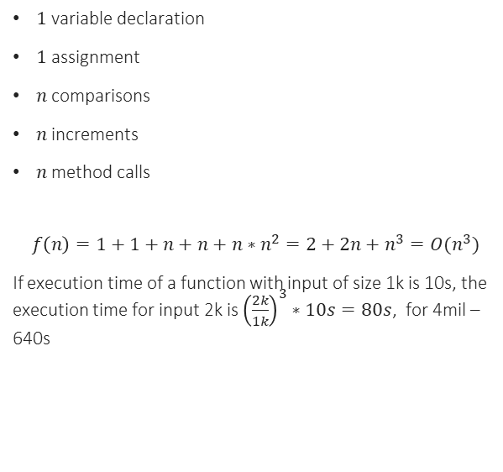
Big-O example
$1$ variable declaration
$1$ assignment
$n$ comparisons
$n$ increments
$n$ method calls
$$f\left(n\right)=1+1+n+n+n∗n^{2}=2+2n+n^{3}=O(n^{3})$$
If execution time of a function with input of size 1k is 10s, the execution time for input 2k is ${\left(\frac{2k}{1k}\right)}^{3}∗10s=80s$, for 4mil – 640s

Slide 11
Big-O example
In real world no one calculates CPU instructions like that, complexity of algorithm is combined from bricks like constructor
for (int I = 0; I < arr.length; i++) {
$$O(n∗n∗1) = O(n^{2})$$
for (int j = 0; j < arr.length; j++) {
Constant time operation
}
}
for (int j = 0; j < arr.length; j++) {
$$O(n∗log⁡n) = O(nlogn)$$
Binary search
}
Total complexity – $O\left(n^{2}\right)+O\left(nlogn\right)=O(n^{2})$

Slide 12
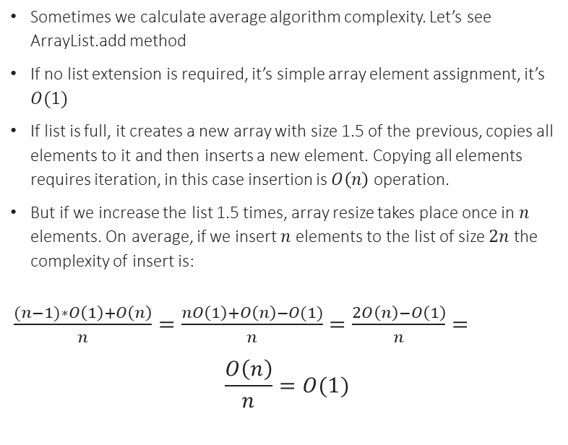
Big-O example
Sometimes we calculate average algorithm complexity. Let’s see ArrayList.add method
If no list extension is required, it’s simple array element assignment, it’s $O(1)$
If list is full, it creates a new array with size 1.5 of the previous, copies all elements to it and then inserts a new element. Copying all elements requires iteration, in this case insertion is $O\left(n\right)$ operation.
But if we increase the list 1.5 times, array resize takes place once in $n$ elements. On average, if we insert $n$ elements to the list of size $2n$ the complexity of insert is:
$\frac{(n−1)∗O\left(1\right)+O\left(n\right)}{n}=\frac{nO\left(1\right)+O\left(n\right)−O(1)}{n}=\frac{2O\left(n\right)−O\left(1\right)}{n}=$
$$\frac{O\left(n\right)}{n}=O(1)$$
Array inside the list:
1. Initial state, 6 elements, size = 8
2. Added 1 element, size = 8
3. Added 1 element, size = 8
4. Adding 1 element, resize required
5-8. Adding 1 element, size = 16

Slide 13
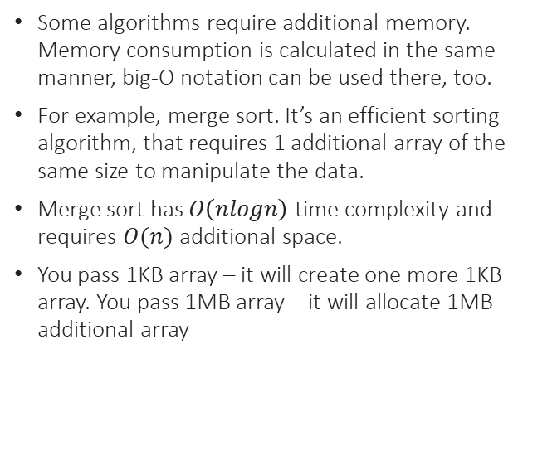
Memory consumption
Some algorithms require additional memory. Memory consumption is calculated in the same manner, big-O notation can be used there, too.
For example, merge sort. It’s an efficient sorting algorithm, that requires 1 additional array of the same size to manipulate the data.
Merge sort has $O\left(nlogn\right)$ time complexity and requires $O(n)$ additional space.
You pass 1KB array – it will create one more 1KB array. You pass 1MB array – it will allocate 1MB additional array

Slide 14

Basic Java operations
Constant time, $O(1)$:
Memory assignment – variable, array element
Memory access – read object property
Method call itself – method implementation can have different complexity
Object creation – constructor is like method, can have different complexity
Arithmetic operations, including comparison
If-then-else statement
System.out.println
Linear time, $O(n)$:
Array copy
Collection iteration
for, for-each loops

Slide 15
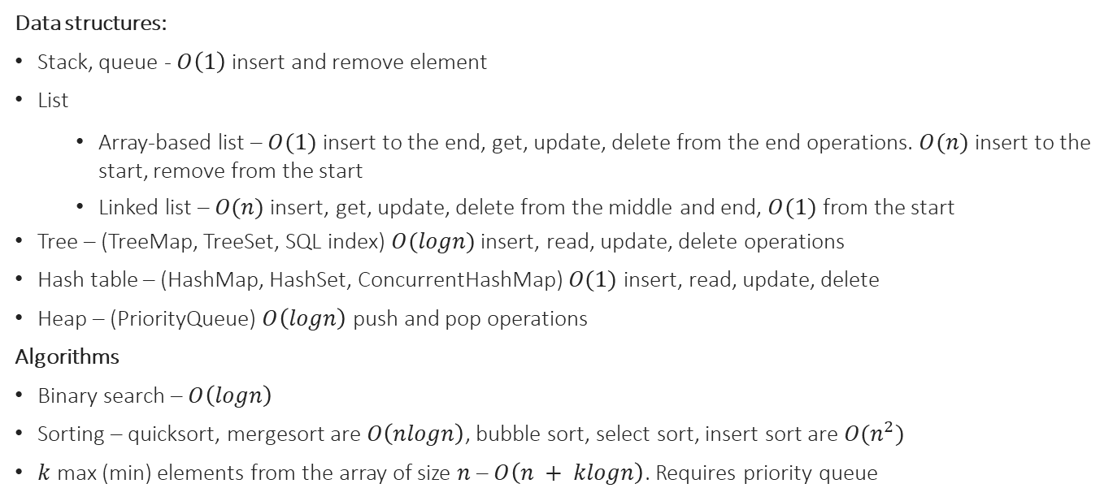
Selected data structures and algorithms
Data structures:
Stack, queue - $O\left(1\right)$ insert and remove element
List
Array-based list – $O(1)$ insert to the end, get, update, delete from the end operations. $O(n)$ insert to the start, remove from the start
Linked list – $O(n)$ insert, get, update, delete from the middle and end, $O(1)$ from the start
Tree – (TreeMap, TreeSet, SQL index) $O(logn)$ insert, read, update, delete operations
Hash table – (HashMap, HashSet, ConcurrentHashMap) $O(1)$ insert, read, update, delete
Heap – (PriorityQueue) $O\left(logn\right)$ push and pop operations
Algorithms
Binary search – $O\left(logn\right)$
Sorting – quicksort, mergesort are $O\left(nlogn\right)$, bubble sort, select sort, insert sort are $O(n^{2})$
$k$ max (min) elements from the array of size $n$ – $O\left(n + klogn\right)$. Requires priority queue

Slide 16
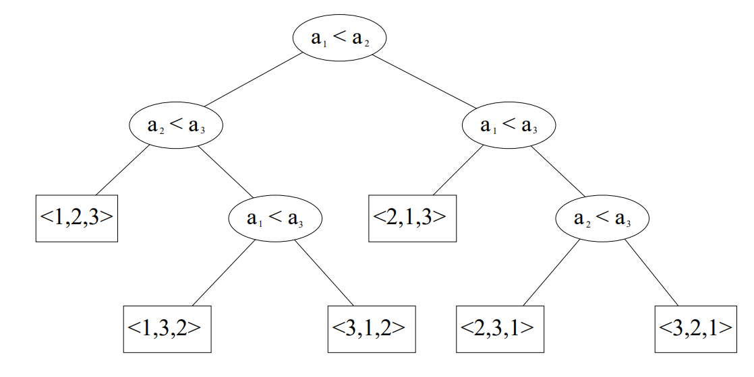
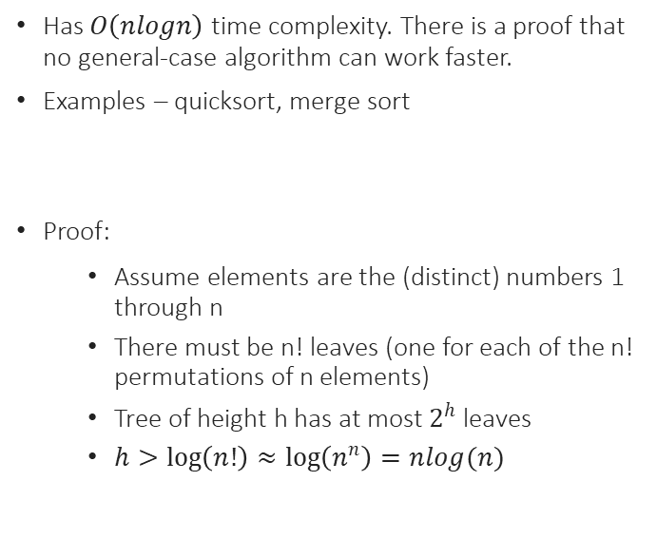
General-case sorting
Has $O\left(nlogn\right)$ time complexity. There is a proof that no general-case algorithm can work faster.
Examples – quicksort, merge sort
Proof:
Assume elements are the (distinct) numbers 1 through n
There must be n! leaves (one for each of the n! permutations of n elements)
Tree of height h has at most $2^{h}$ leaves
$h>\log\left(n!\right)≈\log\left(n^{n}\right)=nlog(n)$

Slide 17
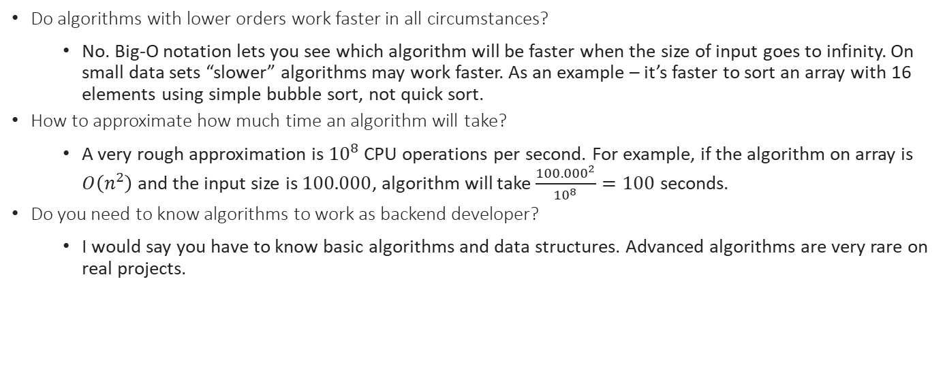
FAQ
Do algorithms with lower orders work faster in all circumstances?
No. Big-O notation lets you see which algorithm will be faster when the size of input goes to infinity. On small data sets “slower” algorithms may work faster. As an example – it’s faster to sort an array with 16 elements using simple bubble sort, not quick sort.
How to approximate how much time an algorithm will take?
A very rough approximation is ${10}^{8}$ CPU operations per second. For example, if the algorithm on array is $O\left(n^{2}\right)$ and the input size is $100.000$, algorithm will take $\frac{{100.000}^{2}}{{10}^{8}}=100$ seconds.
Do you need to know algorithms to work as backend developer?
I would say you have to know basic algorithms and data structures. Advanced algorithms are very rare on real projects.

Slide 18
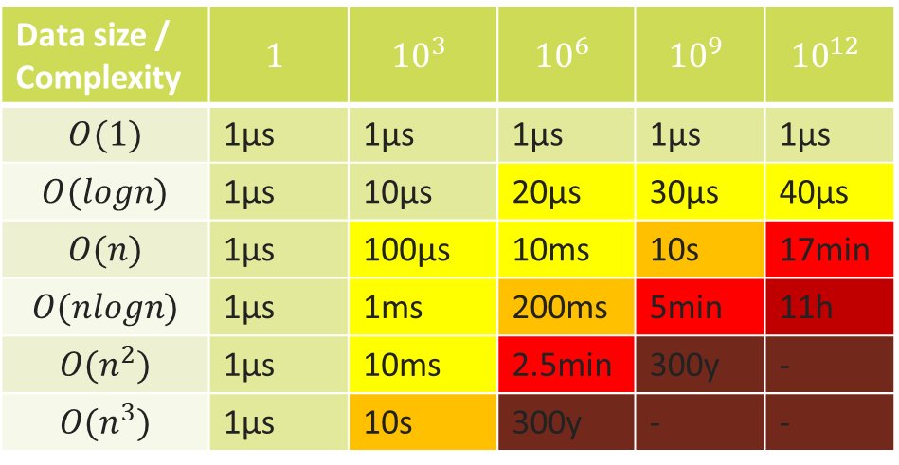
Approximate execution time by algorithm complexity
Data size / Complexity | $$1$$ | $${10}^{3}$$ | $${10}^{6}$$ | $${10}^{9}$$ | $${10}^{12}$$
$$O(1)$$ | 1μs | 1μs | 1μs | 1μs | 1μs
$$O(logn)$$ | 1μs | 10μs | 20μs | 30μs | 40μs
$$O(n)$$ | 1μs | 100μs | 10ms | 10s | 17min
$$O(nlogn)$$ | 1μs | 1ms | 200ms | 5min | 11h
$$O(n^{2})$$ | 1μs | 10ms | 2.5min | 300y | -
$$O(n^{3})$$ | 1μs | 10s | 300y | - | -

Slide 19
Advanced data structures and algorithms
If you’re interested, you can study:
Binary heap, binomial heap
Red-black tree, AVL tree, 2-4 tree
Disjoin-set union
Tree algorithms – BFS, DFS, LCA
Graph algorithms – Kruskal’s, Dijkstra, Floyd Warshall
Sorting – QuickSort, MergeSort, insertion sort, bubble sort, count sort

Slide 20
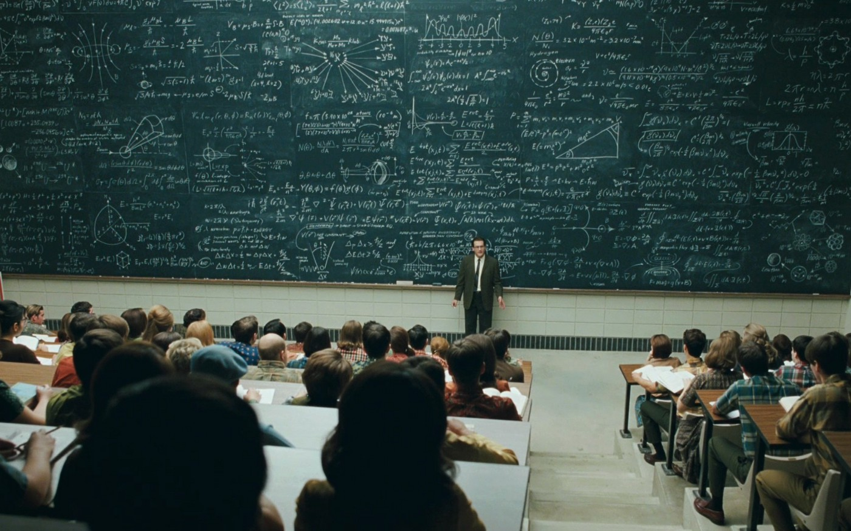
QA
Do you have any questions?

